Slide 1
greg.rafferty@gmail.com
Apr ‘21

Slide 2
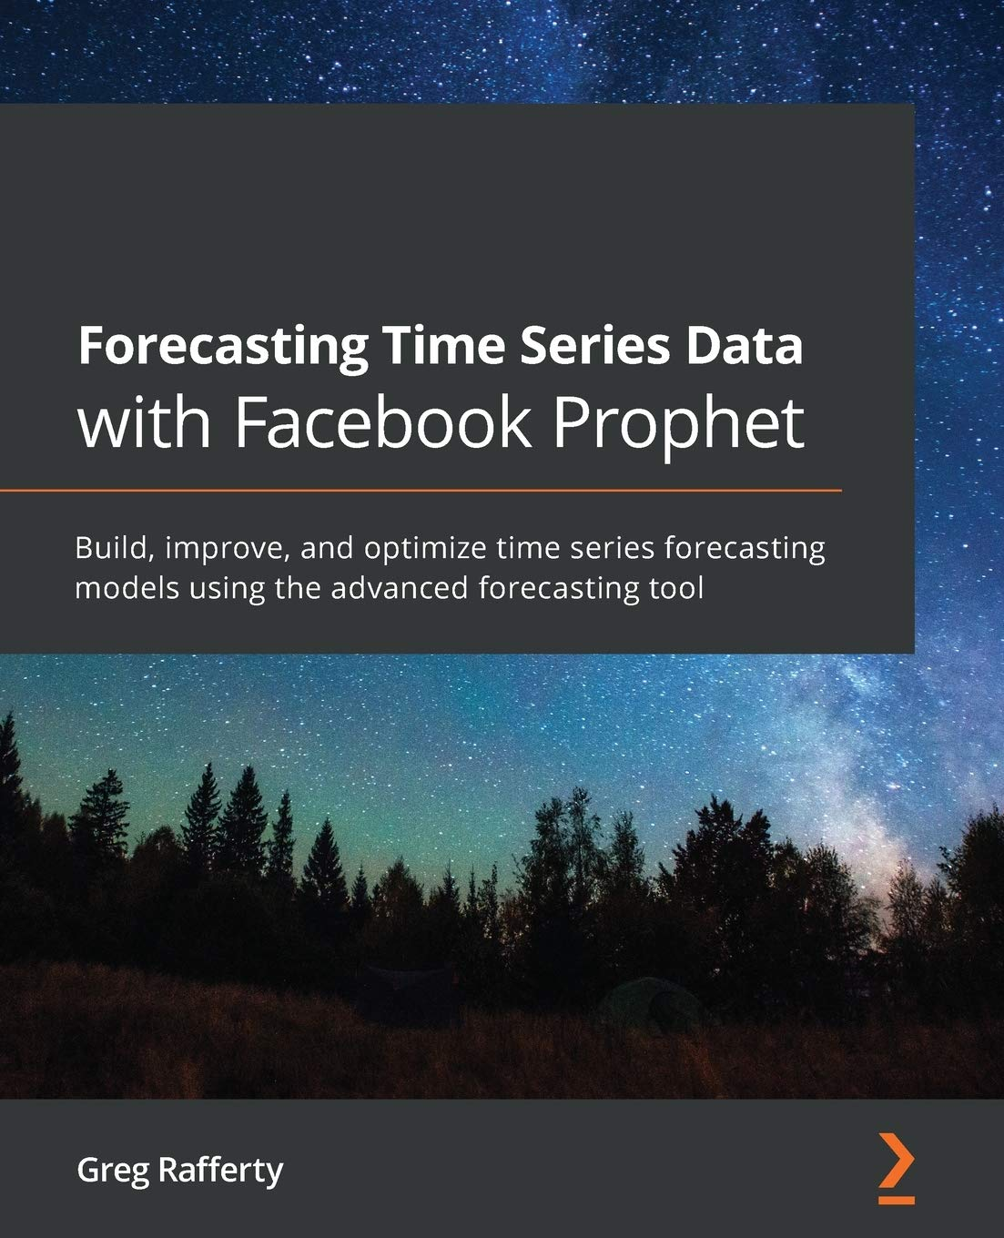
About
Prophet is Facebook’s internal business forecasting tool. In 2017, Facebook open sourced Prophet under an MIT license.
I’m Greg Rafferty, a product analyst at Google.
I have not worked at Facebook, but I am a contributor to the Prophet GitHub repo. During the lockdowns, I wrote a book about Prophet.
https://amzn.to/373oIcf (Amazon link)

Slide 3

Agenda
Where Prophet shines
How Prophet works
Walkthrough an example forecast

Slide 4
Where Prophet Shines

Slide 5
Business forecast tasks at Facebook
Hourly, daily, or weekly observations with at least a few months (preferably a year) of history
Strong multiple “human-scale” seasonalities: day of week and time of year
Important holidays that occur at irregular intervals that are known in advance (e.g. the Super Bowl)
A reasonable number of missing observations or large outliers
Historical trend changes, for instance due to product launches or logging changes
Trends that are nonlinear growth curves, where a trend hits a natural limit or saturates

Slide 6
Motivation behind Prophet
Completely automatic forecasting techniques are often too inflexible to incorporate useful assumptions.
Analysts who can produce high quality forecasts are quite rare because forecasting is a specialized data science skill requiring substantial experience.
The result of these themes is that the demand for high quality forecasts often far outstrips the pace at which analysts can produce them. Facebook wanted to make it easier for experts and non-experts to make high quality forecasts that keep up with demand.
Prophet makes it much more straightforward to create a reasonable, accurate forecast.
Prophet forecasts are customizable in ways that are intuitive to non-experts.
Notes:
Completely automatic forecasting techniques can be brittle and they are often too inflexible to incorporate useful assumptions or heuristics.
Analysts who can produce high quality forecasts are quite rare because forecasting is a specialized data science skill requiring substantial experience as well as domain knowledge.
The result of these themes is that the demand for high quality forecasts often far outstrips the pace at which analysts can produce them. Facebook wanted to make it easier for experts and non-experts to make high quality forecasts that keep up with demand.
Prophet makes it much more straightforward to create a reasonable, accurate forecast. Choosing the wrong model or parameters can often yield poor results, and it is unlikely that even experienced analysts can choose the correct model and parameters efficiently given the array of forecasting models.
Prophet forecasts are customizable in ways that are intuitive to non-experts. There are smoothing parameters for seasonality that allow you to adjust how closely to fit historical cycles, as well as smoothing parameters for trends that allow you to adjust how aggressively to follow historical trend changes. For growth curves, you can manually specify “capacities” or the upper limit of the growth curve, allowing you to inject your own prior information about how your forecast will grow (or decline). Finally, you can specify irregular holidays to model like the dates of the Super Bowl, Thanksgiving and Black Friday.

Slide 7
Analyst-in-the-loop approach to forecasting at scale
Modeling
Visually Inspect Forecasts
Forecast Evaluation
analyst-in-the-loop
automated
Surface Problems
Notes:
The analyst-in-the-loop approach to business forecasting is started by modeling the time series in a way which has a straightforward human interpretation for each of the parameters. The model then produces a forecast and predicts historical dates for which actual data is known, in order to evaluate the performance. When there is poor performance or other aspects which warrant human intervention. The model then flags these potential problems to the human analyst, who can then inspect the forecast and adjust the model accordingly.

Slide 8
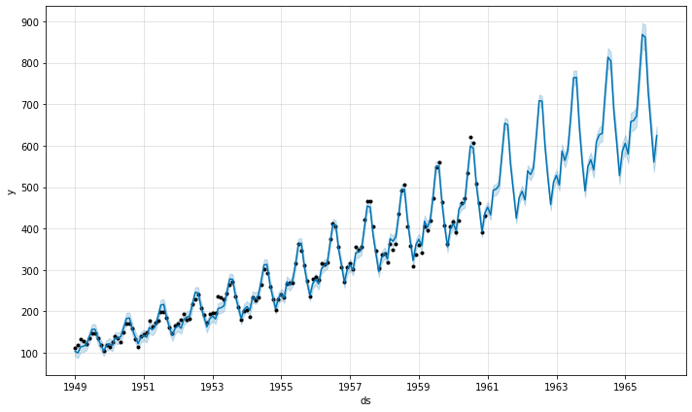
Air Passengers example
from prophet import Prophet
import pandas as pd
df = pd.read_csv('AirPassengers.csv',
names=['ds', 'y'], header=1)
m = Prophet(seasonality_mode='multiplicative')
m.fit(df)
future = m.make_future_dataframe(periods=60, freq='MS')
forecast = m.predict(future)
fig = m.plot(forecast)
Data: https://www.kaggle.com/rakannimer/air-passengers
Notes:
Forecasting 5 years of future passenger numbers is accomplished in Prophet with these 8 lines of code

Slide 9
How Prophet Works

Slide 10
Architecture
Python
PyStan
Stan
mc-stan.org
RStan
R
The core Prophet model is built in Stan, which is treated as a Black Box—most users will never need to peer inside.
Original Prophet paper:
https://peerj.com/preprints/3190/
The user interacts with Prophet via APIs available in both Python and R
Prophet documentation:
https://facebook.github.io/prophet/
Notes:
Stan is a probabilistic programming language for statistical inference written in C++. The core Prophet model is built in Stan while the user interacts with it via either Python or R. My book concentrates on the Python side of things, but the Python and R versions are on feature parity so the same concepts apply.

Slide 11
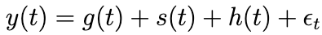
Prophet forecasting model
Growth
Seasonality
Holidays
error
Notes:
The Prophet model consists of four terms: growth, seasonality, holidays and special events, and irreducible error

Slide 12
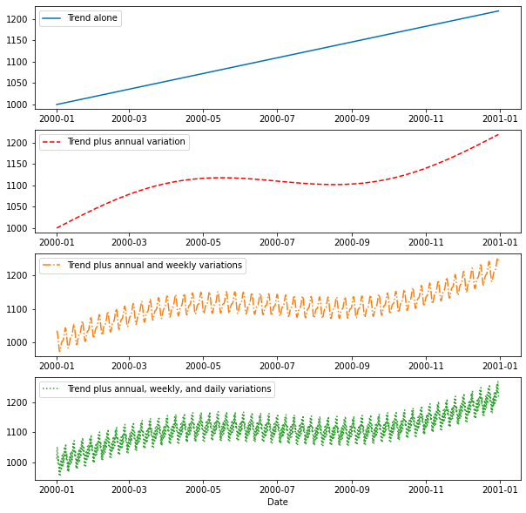
Additive regression model
A piecewise linear or logistic growth curve trend. Prophet automatically detects changes in trends by selecting changepoints from the data
A yearly seasonal component modeled using Fourier series
A weekly seasonal component modeled using Fourier series
A list of important holidays or special events
Any additional regressors or custom seasonalities
Notes:
These terms are simply added up to create the final curve. Using a log transformation, the model can be made multiplicative instead of additive.

Slide 13
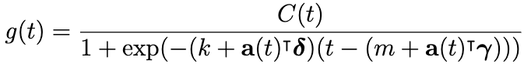
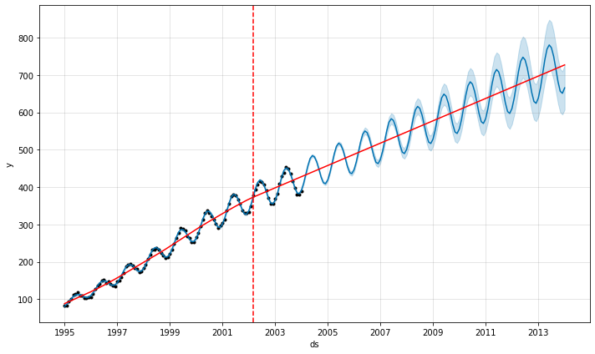
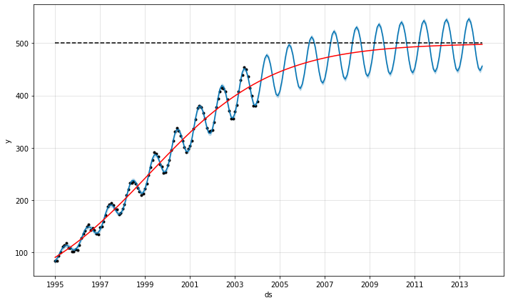
Trend model
Linear with changepoints
Nonlinear with saturating growth
Notes:
Prophet supports two mains trend modes: linear and logistic. Both modes allow changepoints to alter the slope. There is a third mode, flat, which is similar to linear but always has zero slope, and no changepoints (essentially, modeling only seasonality and holidays). With the logistic mode, a cap must be specified and optionally a floor. The floor allows the logistic model to reduce asymptotically.

Slide 14
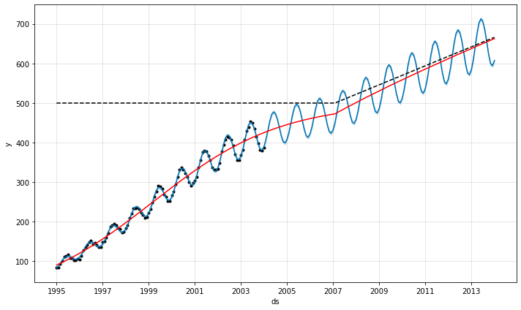
Trend model
Linear with changepoints
Nonlinear with saturating growth
Notes:
The logistic cap (and floor) is a function of time, and so needn’t be constant.

Slide 15
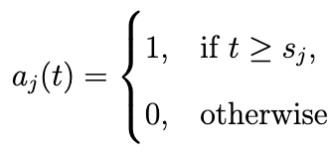
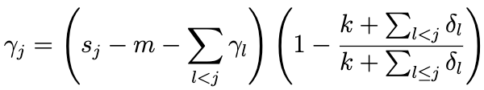
Changepoints
Linear
Logistic
Expected capacity (for logistic trend)
Growth rate
Offset parameter
Vector representing the sum of changepoints up until time t
Vector representing the adjustment to m which is necessary to connect the endpoints of the line segments
Vector of rate adjustments
Notes:
C(t) is the asymptote for logistic growth.
k and m are the slope and y-intercept, at a given point in time
a(t), lambda, and delta are adjustment parameters which change k and m based upon changepoints.

Slide 16
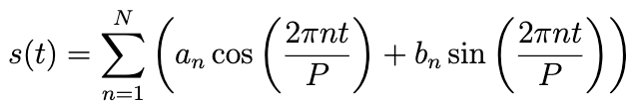
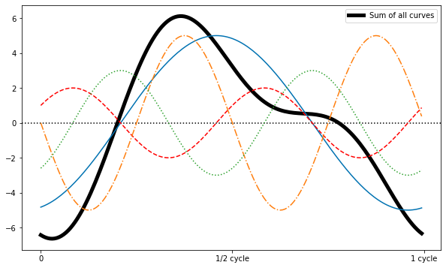
Seasonality
Period of seasonality
(eg, 7 for weekly, 365.25 for yearly)
Fourier order
,
Fitting parameters
Notes:
Seasonality is modeled with a Fourier series, essentially a sum of many sine and cosine waves. The Fourier order is the number of waves included in the sum; higher Fourier orders result in a more flexible curve. With a high enough Fourier order, any arbitrarily complex cycle can be represented.

Slide 17
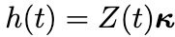
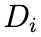
Holidays and special events
Set of past and future dates for holiday i
Vector representing the change in the forecast due to each holiday
Notes:
Holidays are modeled with a list of relevant dates, essentially a flag for whether or not an effect should be applied, and a vector of effect magnitudes for those holidays.

Slide 18
Model fitting
Model is fit using Stan’s L-BFGS maximum a posteriori (map) estimate by default
Provides uncertainty intervals only for the trend
Analyst may choose to fit using Markov Chain Monte Carlo (mcmc) sampling
Much slower, but provides uncertainty intervals for all model components

Slide 19
Analyst-in-the-loop modeling
Capacities
Domain knowledge for total market size
Changepoints
Known dates of changepoints, such as product releases
Holidays and seasonality
Different holidays in different regions
One-off events such as sales or marketing promotions
Multiple seasonalities with different time scales (quarterly, hourly, etc.)
Smoothing parameters
Global or locally smooth models
How much of the historical seasonal/holiday variation is expected in the future

Slide 20
Example Forecast

Slide 21

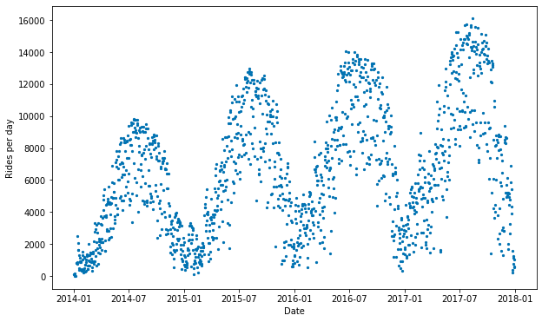
Divvy data
go/prophet-colab
Notes:
Divvy is a bike share program in Chicago. Here, we have the number of riders per day on the system over a period of four years. The data exhibits clear seasonality with low ridership numbers in the winter and high ridership numbers in the summer, and a general increasing trend from year to year throughout the data range. There is a lot of daily variance though.

Slide 22
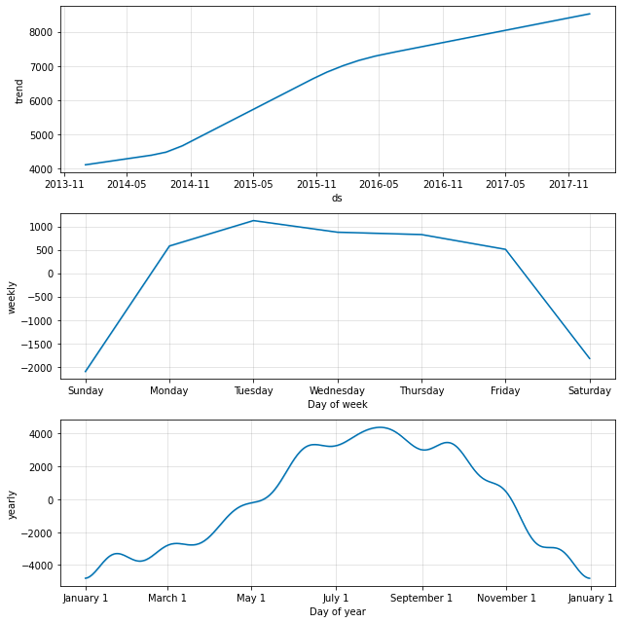
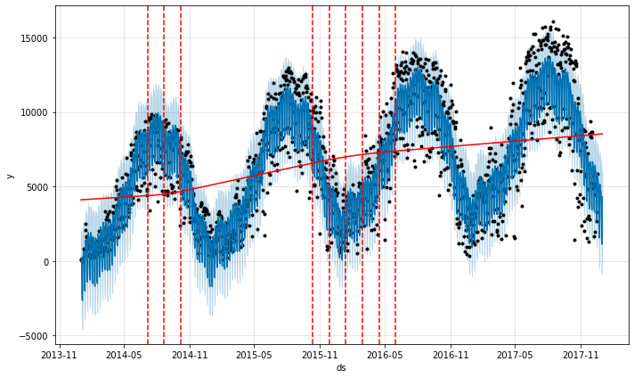
Simple forecast
Notes:
Things to note:
The forecast predicts negative ridership at times. Solution: clip data, but lose CI. Or see ProphetPos on GitHub issues for solution.
Yearly seasonality is wavy. Next model will reduce the Fourier order
Variance from day-to-day can partially be explained by the weekly seasonality. Ridership is high on weekdays but low on weekends, possibly due to work commuters.

Slide 23
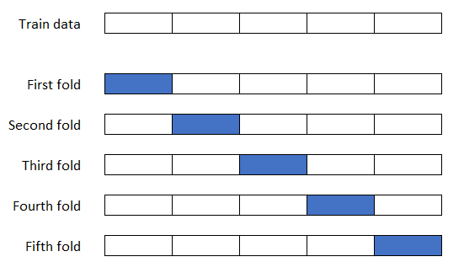
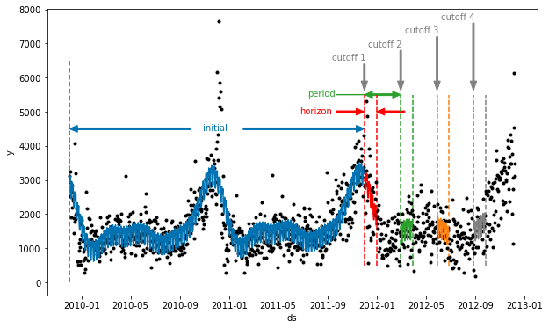
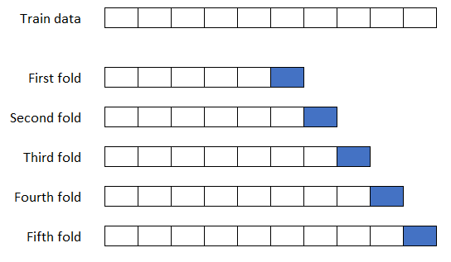
Time series cross validation
k-fold cross-validation
Forward-chaining cross-validation
Notes:
Time series data cannot use the k-fold cross validation common in other machine learning applications due to the fact that the data points are not independent of each other and cannot be shuffled around. Forward-chaining cross validation is one solution to this problem.

Slide 24
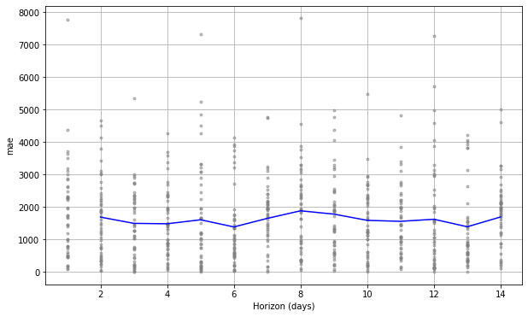
Cross validation results
Notes:
It appears that our simple forecast has a mean absolute error of somewhere around 1600 riders per day. Given that upwards of 10,000 riders use the system each day, this is not a bad error rate. But we can do better.

Slide 25
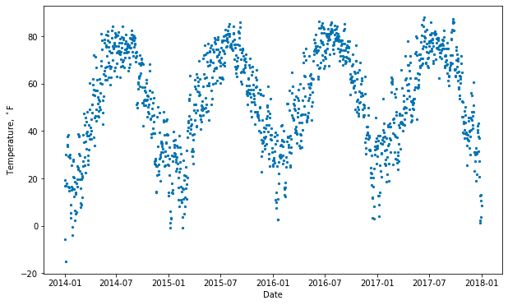
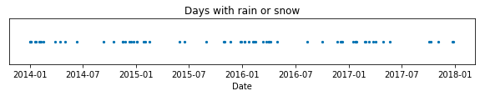
Model additions
Extra regressors: temperature, precipitation
Holidays
New Year’s Day
Martin Luther King Jr. Day
Washington’s Birthday
Memorial Day
Independence Day
Labor Day
Columbus Day
Veterans Day
Thanksgiving
Christmas Day
Christmas Day (Observed)
New Year’s Day (Observed)
Veterans Day (Observed)
Independence Day (Observed)
Notes:
We will build a more complex model by adding an additional regressor for the temperature and another for the precipitation. We will also add in US holidays. Finally, the model presented next uses a few parameter tweaks for optimization. See the colab for details.

Slide 26
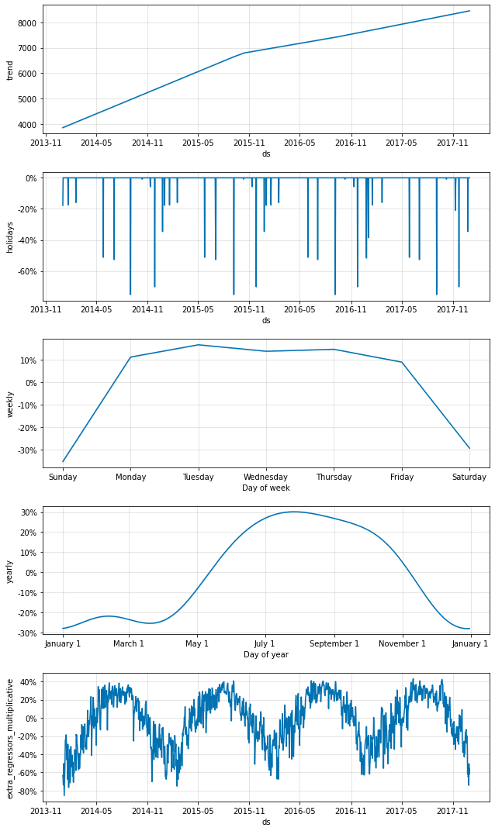
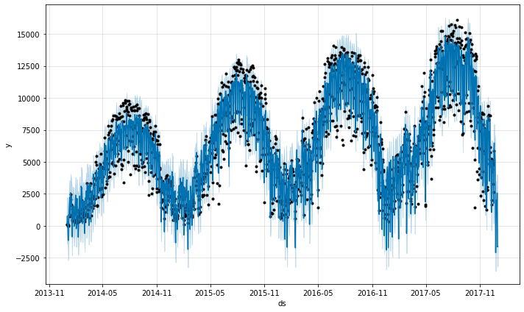
Complex forecast
Notes:
Our complex model appears similar to our basic one. The trend has fewer changepoints, due to a changed changepoint_prior parameter, and our yearly seasonality is smoother, due to a changed Fourier order.

Slide 27
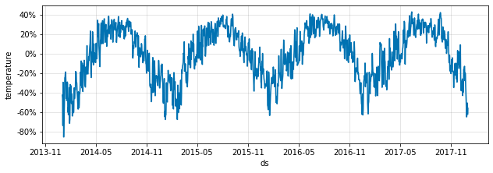
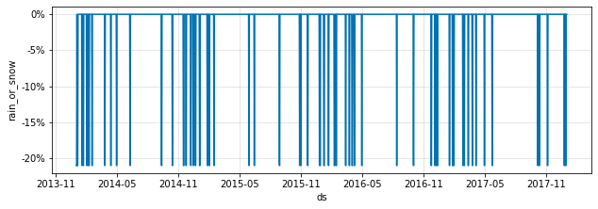
Complex forecast
Notes:
We have two additional plots in the plot_components result: holidays and extra_regressors_multiplicative. This latter plot can be further divided into its constituent parts, temperature and rain_or_snow. We can see that precipitation causes a ~21% reduction in ridership. It is difficult to see what effect temperature has because it is not directly plotted. The next slide takes care of that.

Slide 28
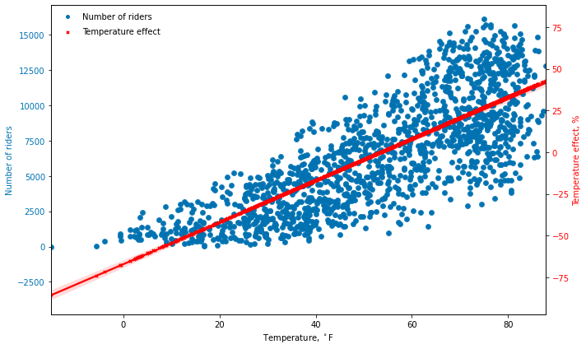
Extra regressors: temperature
Extra regressors are always linear
Notes:
Plotting temperature directly against the effect it has demonstrates that Prophet always models extra regressors as linear. In this case, this linear assumption is decent at temperatures greater than ~20F, but below that value the model predicts fewer riders than actual.

Slide 29
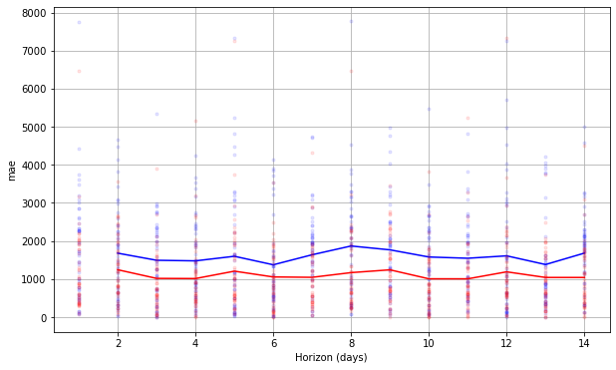
Cross validation results
Basic model
Complex model
Notes:
Comparing the mean absolute error of our first model (basic) and our second model (with the additional regressors and holidays) shows that the advanced model improved prediction accuracy by about 500 riders per day.

Slide 30
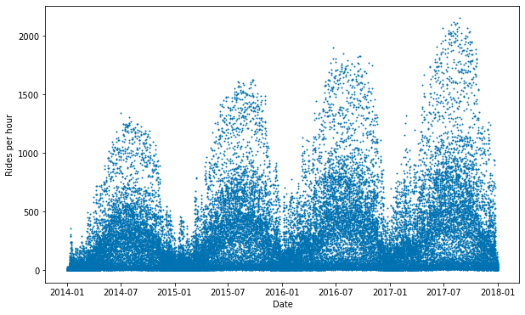
Divvy - hourly data
Notes:
In order to demonstrate a few other features of Prophet, we will now look at hourly Divvy data. It appears similar to the daily data, but with far more variance.

Slide 31
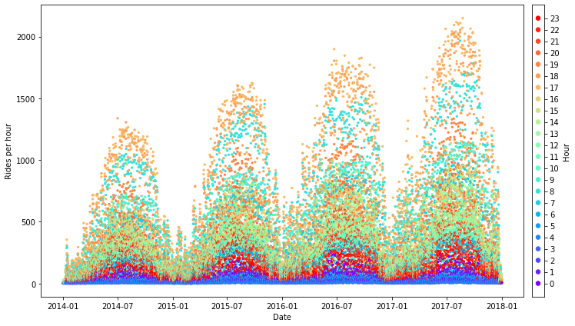
Divvy - hourly data
Notes:
Coloring those data points by the hour of the day reveals a pattern: the dark blue points and red points are overnight; the orange and cyan points are at peak ridership periods. It appears that there are two distinct periods of peak ridership, around 5pm and 8am.

Slide 32
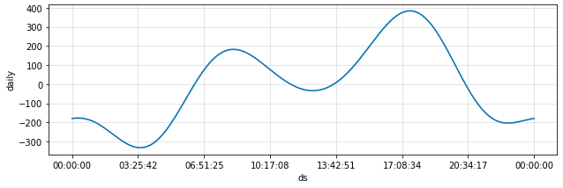
Custom seasonalities
Daily seasonality
Notes:
Building our model and plotting the daily seasonality shows these two peaks. One occurs around 8am and the other around 5pm. This lends further evidence to our hypothesis that Divvy riders are largely work commuters.

Slide 33
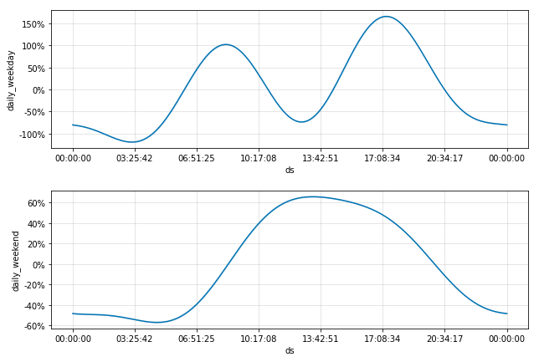
Custom seasonalities
Daily seasonality
Conditional seasonality
Notes:
We can use Prophet’s Conditional Seasonality to plot separate daily seasonalities for the weekdays and the weekends. This results shows us that on weekdays, there is indeed a bimodel pattern with peak ridership during the morning and evenings commutes and a trough around lunchtime. But on weekends, riders start a bit later but ride constantly throughout the day, there is no noon-time reduction.

Slide 34
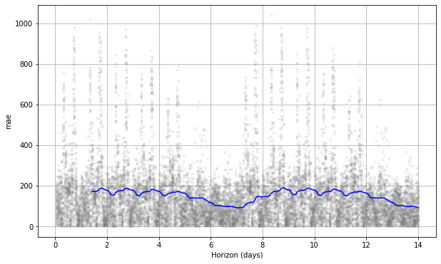
Cross validation results
Notes:
Interesting pattern: Mean Average Error is lowest just after midnight and highest around noon each day, and lowest overall on weekends. This mirrors the variance of riderships, with high variance during the day and low at night and over weekends.

Slide 35
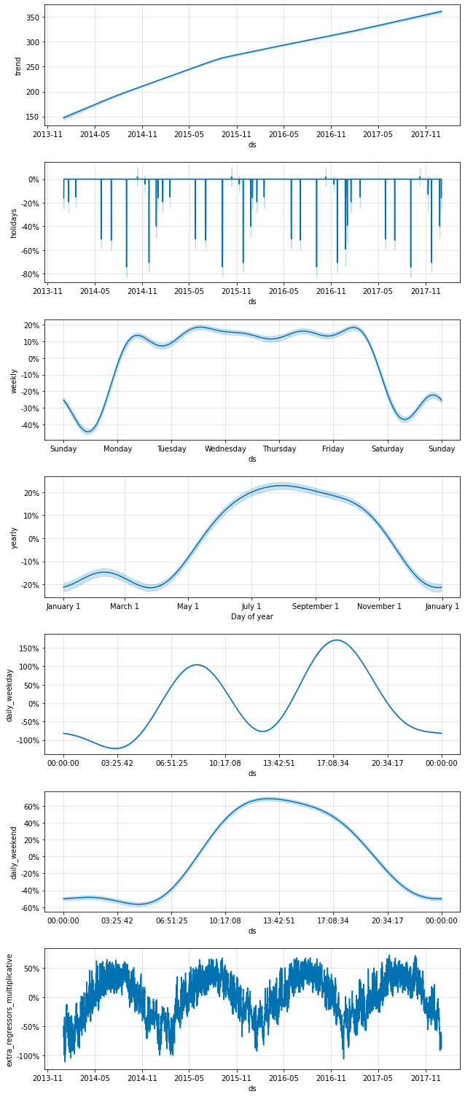
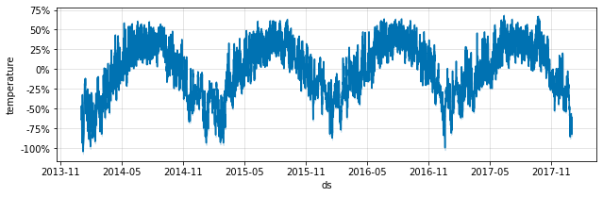
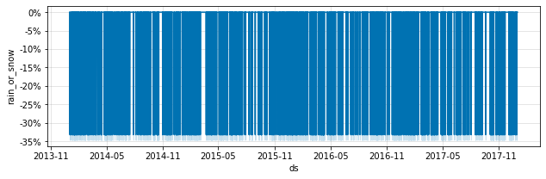
MCMC sampling
Notes:
Finally, bringing all of these model features together and using MCMC sampling in order to create uncertainty intervals around each component is possible, although training this model took about 10 hours. Note that the rain_or_snow plot shows an incredibly high density of hours with rainfall or snowfall. This is just an illusion. There are about 35,000 hours in this four-year period, and only about 3000 of them had precipitation logged. However, the line as plotted by Prophet has a thickness roughly equal to one week, so if there was rainfall during a single hour of any week, that hour’s line would appear to be solid across the week.

Slide 36
Resources

Slide 37
Resources
This deck
Code for the Air Passengers and Divvy examples
Amazon link to the book
GitHub repo with code and data for examples in the book

Slide 38
Appendix

Slide 39
P R O P H E T

Slide 40
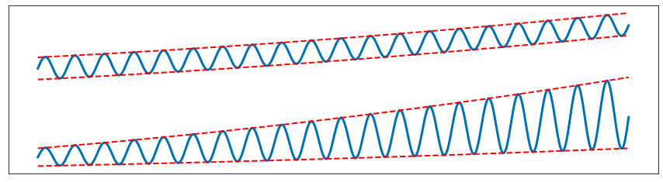
Fig. 4.1
“Fig. 4.1 is a really nice illustration.”
- Ben Letham, one of the original Prophet authors

